Slide 1
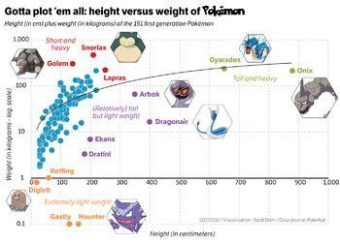
Beginner’s guide to ggplot2
Kirsten Isabel Verster

Slide 2

Itinerary
On the “grammar of graphics”
The syntax and elements of a ggplot2 object
Several practical examples using Pokemon dataset (follow along on https://github.com/kirver/ggplot2)

Slide 3
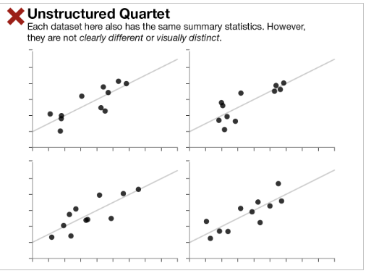
The importance of graphical representation

Slide 4
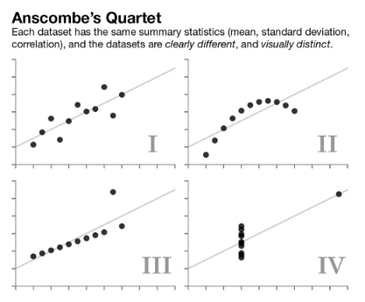
The importance of graphical representation
F.J. Anscombe in 1973: The effectiveness of Anscombe's Quartet is not due to simply having four different datasets which generate the same statistical properties, it is that four clearly different and visually distinct datasets are producing the same statistical properties.
He described it as countering the impression that “numerical calculations are exact, but graphs are rough”.

Slide 5
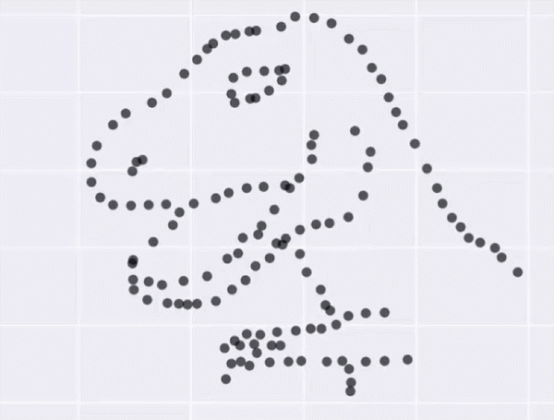
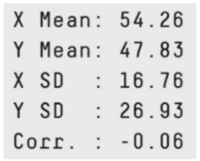
The Datasaurus Dozen
Summary stats are deceptive, make pretty pictures!
Alberto Cairo created the Datasaurus dataset which urges people to "never trust summary statistics alone; always visualize your data“.
tinyurl.com/gg2022sssg
Notes:
Matejka and Fitzmaurice made 200,000 incremental changes to the Datasaurus data set, slightly shifting points so that the summary statistics stayed within one-hundredth of the originals

Slide 6
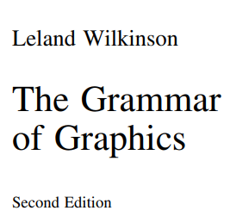
The Grammar of Graphics
Grammar is defined as a set of structural rules which helps define and establish the components of a language
A grammar of graphics is a framework that enables us to concisely describe the components of any graphics
A GOG follows a layered approach by using defined components to build a visualization
The whole system and structure of a language usually consists of syntax and semantics
tinyurl.com/gg2022gog
Notes:
First proposed by Leland Wilkinson

Slide 7
Object oriented graphics system
A graph is a set of points. It cannot be seen.
A graphic is a physical representation of a graph. This representation is accomplished by realizing graphs with aesthetic attributes like size or color
From the OOD perspective, graphics are collections of objects. If the messages between objects follow a simple grammar, they will behave consistently & flexibly
The three stages of graphic creation are:
Assembly
Display
Specification
tinyurl.com/gg2022gog
Notes:
A graph is a set of points. A mathematical graph cannot be seen. It is an abstraction. A graphic, however, is a physical representation of a graph. This representation is accomplished by realizing graphs with aesthetic attributes such as size or color.
An object-oriented graphics system requires explicit definitions for these realizations and rules for relating them to data and for organizing their behavior in a computational environment. If we are lucky, this graphics system should have generality, yet will rest on a few simple objects and rules. This book is an attempt to reveal the richness of such a system. From the OOD perspective, graphics are collections of objects. If the messages between these objects follow a simple grammar, then they will behave consistently and flexibly. To introduce this idea, we will focus on three stages of graphic creation: 1) Specification 2) Assembly 3) Display After introducing these stages, we will show how they work in an example.
https://link.springer.com/content/pdf/10.1007%2F0-387-28695-0.pdf
But this wasn’t like actually a coding language YET
Specification involves the translation of user actions into a formal language. The user may not be aware of this language, but it is required for an automated system to understand the graphic request. Another way of defining specification is to say that it is the deep grammar of a graphic. A graphic, unlike a picture, has a highly organized and constrained set of rules. A picture, of course, has its own rules, especially real pictures such as photographs and videos (Biederman, 1981). Nevertheless, an artist is privileged to bend the rules to make a point (Bosch, Dali, or Picasso, obviously, but also Rembrandt, Cezanne, or Close). And a special-effects technician may use tricks to make us think that a video or virtual scene is more real than what we observe in our daily lives. Not so with graphics. We have only a few rules and tools. We cannot change the location of a point or the color of an object (assuming these are data-representing attributes) without lying about our data and violating the purpose of the statistical graphic — to represent data accurately and appropriately. Consequently, the core of a graphics system must rest on specification.
Statistical graphic specifications are expressed in six statements: 1) DATA: a set of data operations that create variables from datasets, 2) TRANS: variable transformations (e.g., rank), 3) SCALE: scale transformations (e.g., log), 4) COORD: a coordinate system (e.g., polar), 5) ELEMENT: graphs (e.g., points) and their aesthetic attributes (e.g., color), 6) GUIDE: one or more guides (axes, legends, etc.).
A scene and its description are different. In order to portray a scene, we must coordinate its geometry, layout, and aesthetics in order to render it accurately. A statistical graphics computer program must be able to assemble a graphical scene from a specification in the same manner as a drawing or modeling program puts together a realistic scene from specification components. This book is more about specification than scene assembly, but it is important to think about assembly while learning about specification so that we do not confuse surface features with deep structures. How we build a scene from a specification affects how the result behaves. A scene can be dynamic or static, linked to external data or isolated, modifiable or immutable, depending on how we assemble it
For us to perceive it, a graph must be rendered using aesthetic attributes and a display system (e.g., paper, video, hologram). Contemporary operating systems provide access to rendering methods, preferably through well-defined, abstract interfaces. Production graphics require little in this area other than basic drawing capabilities. Dynamic graphics and scientific visualization, by contrast, require sophisticated designs to enable brushing, drill-down, zooming, linking, and other operations relating data to graphics. Becker and Cleveland (1987), Cleveland and McGill (1988), Cook and Weisberg (1994), and Swayne et al. (1998) introduce these issues. More recently, virtual reality displays and immersive environments have expanded the available aesthetics to touch and sound.

Slide 8
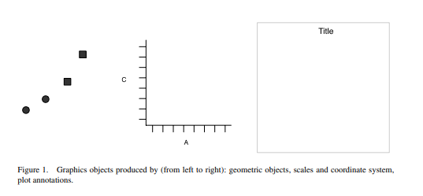
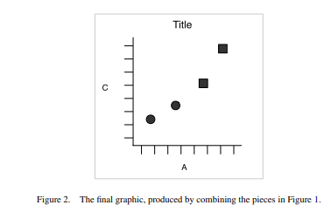
Layered grammar of graphics
Created by Hadley Wickham
https://tinyurl.com/gg2022layered1
Notes:
Table 1 – a simple dataset
You can create many different types of plots using these specifications. Line plot. Bar plot. Bars, lines and points are all examples of geometric objects.
To create a combined plot we need to combine graphical obects from these sources: the data, represented by something called geom; the scales and coordinate system, which generates axes and legends so we can read values from the graph; and the plot annotations, such as the background an dplot title.

Slide 9
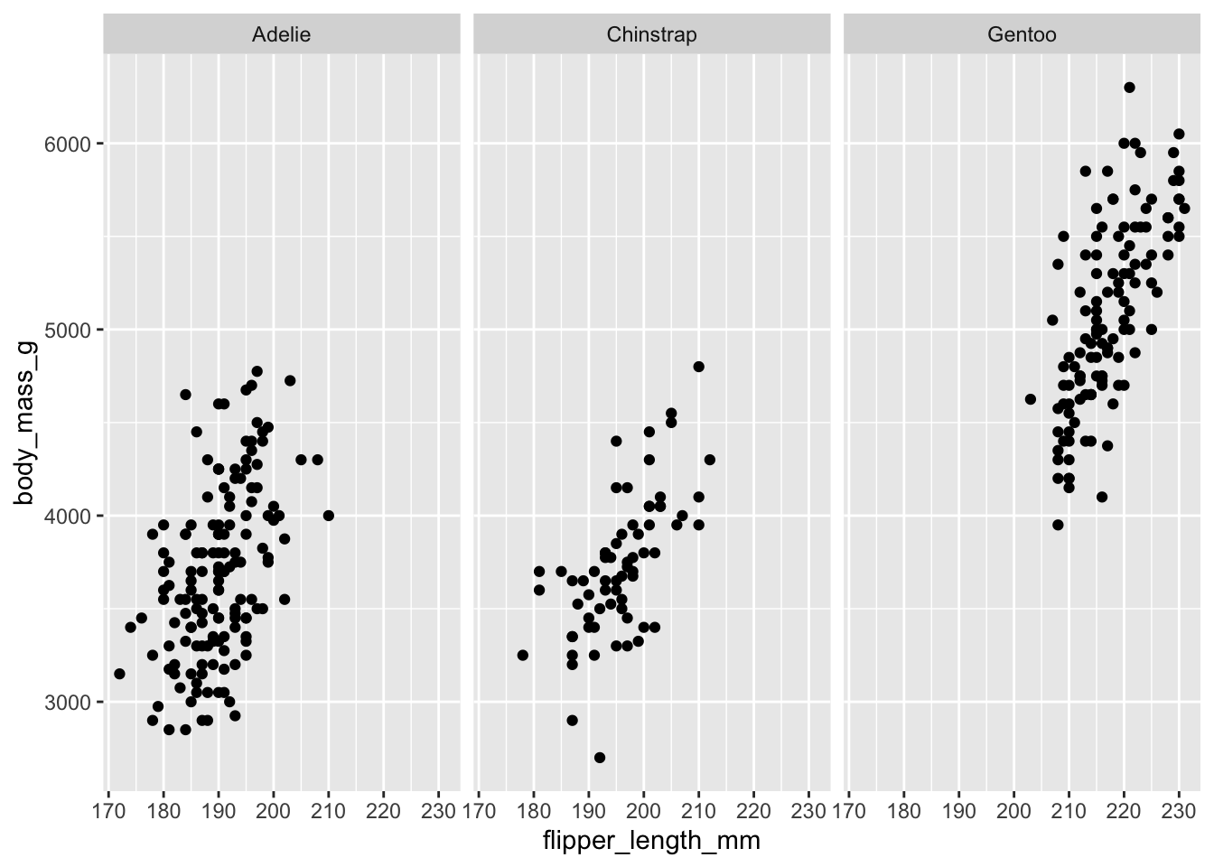
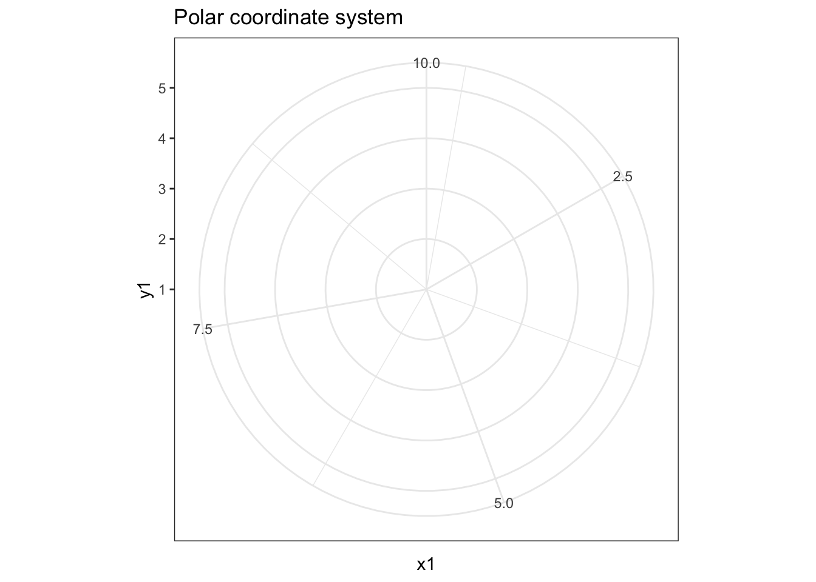
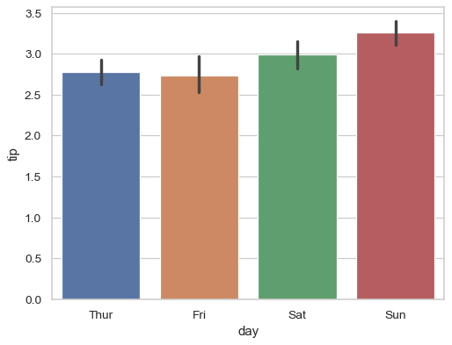
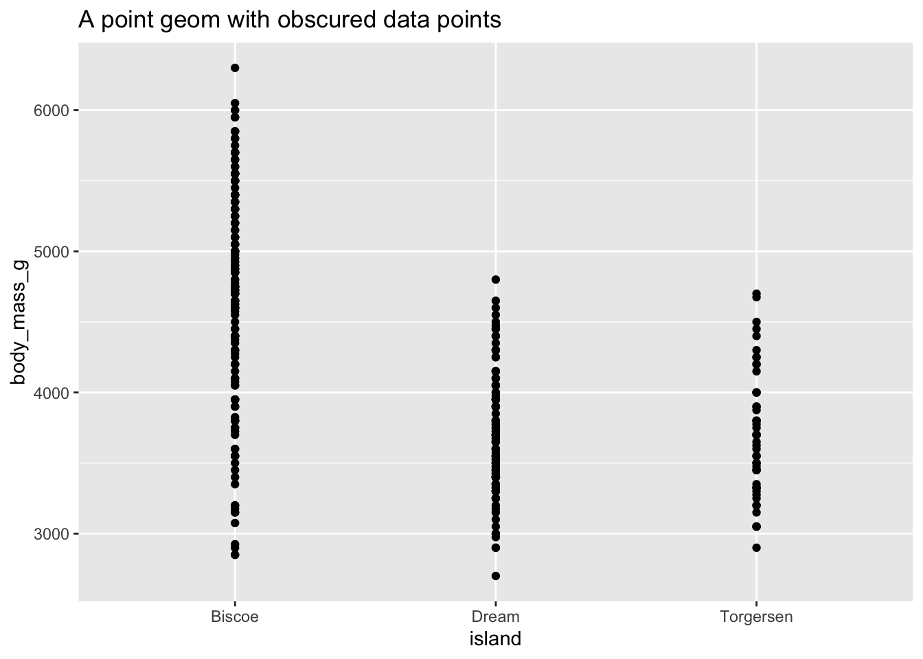
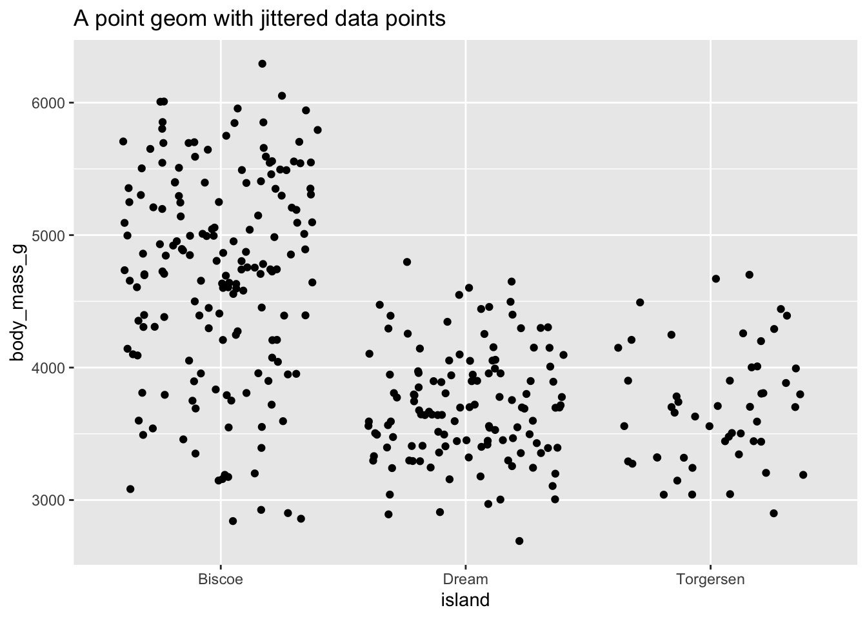
Components of the layered grammar
Layer
Data
Mapping
Statistical transformation (stat)
Geometric object (geom)
Position adjustment (position)
Scale
Coordinate system (coord)
Faceting (facet)
Defaults
Data
Mapping
https://tinyurl.com/gg2022uchic
Notes:
Layers are related to each other and share many common features. For example, multiple layers can be built using same underlying data – like a scatterplot overlayed w a smoothed regression line
Data defines the source of information to be visualized, but is independent from other elements
Mapping defines how variables are applied to the plot. (what is in x position, what is in y position?)
Stat – transforms the data. E.g. a bar graph, you are not graphing the raw data, but rather the mean and the SE. takes in a dataset as input and returns a diff dataset as the output.
Geoms – control type of plot you create. Classified by their dimentionality – 0 dimensions, point, text; 1 dim, path, line, 2d, polygon, interval.
Position adjustment e.g. stack, dodge to avoid bars overlapping.
Scale - controls how data is mapped to aesthetic attributes; e.g. color scale;
Coord- maps positions of objects onto the plane of th eplot, controls how the axes and grid lines are drawn. Usually 2 coordinates, but could be more. E.g. Cartesian (this one), or polar.
Faceting – can split the data up into subsets of the entire dataset. Allows subsets to be visualized on the sam eplot
Default – simplified grammar

Slide 10

Ggplot2 is a package implementation of the layered Grammar of Graphics
ggplot2 is a powerful and a flexible R package, implemented by Hadley Wickham, for producing elegant graphics. The gg in ggplot2 means Grammar of Graphics.
tinyurl.com/gg2022layers

Slide 11
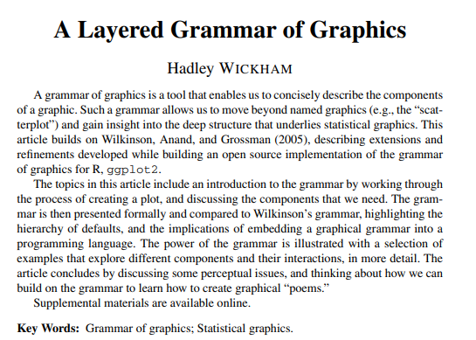
Ggplot2 is a package implementation of the Grammar of Graphics
ggplot2 is a powerful and a flexible R package, implemented by Hadley Wickham, for producing elegant graphics. The gg in ggplot2 means Grammar of Graphics.
tinyurl.com/gg2022layers

Slide 12
Pulling them all together
Running ggplot() creates a new plot object in the existing R language
Then you add a single layer, specifying the data, mapping, geom & stat, position scales, and coordinate systems
Any aesthetics specified in the layer will override defaults
Notes:
Pg 15 from Wickham

Slide 13
Time to walk through some common graph types!
https://github.com/kirver/ggplot2

Slide 14
Go thru script showing basic types of graphs
Starting with scatter plots and LOTS of iterations
Lots of histogram iterations
Boxplot
Colorblind friendly graphs

Slide 15
Maybe add
Pie chart?
Heat map?
Reverse engineering how to figure out k hace el codigo

Slide 16
Some helpful links
https://rafalab.github.io/dsbook/ggplot2.html
https://towardsdatascience.com/a-comprehensive-guide-to-the-grammar-of-graphics-for-effective-visualization-of-multi-dimensional-1f92b4ed4149
http://r-statistics.co/Top50-Ggplot2-Visualizations-MasterList-R-Code.html

